Slide 1
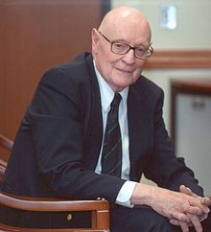
Plausible Reasoning
Based on the ideas of Nicholas Rescher
By: Douglas McManaman

Slide 2

{p → q; p; ~q; r; ~r ↔ p}
There is a plethora of data in our minds, and much
of it is inconsistent.
Consistent thinking is about bringing consistency to that data.
When I saw that
motorcade, I
couldn’t help but
give him the
finger.
{[(p → q) & r]; q; ~p}
I hate Donald
Trump; he has
no impulse
control

Slide 3
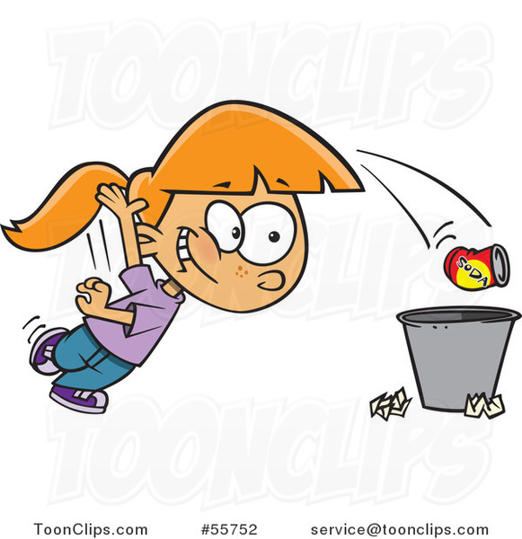
Bringing order to the mind is about discarding inconsistent data
p; ~r ↔ p; ~q

Slide 4
Plausibility Reasoning
Plausibility is fundamentally about reliability of the sources which issue or authorize claims.
“Sources” — understood in a wide sense:
Persons who make claims (experts, eye witnesses, contemporary diarists, etc.)
Depersonalized historical sources (“oral tradition,” “rumor”, “newspaper accounts,” “common knowledge,”, etc.)
Our own various observational data-sources (especially sense-perception and memory)
Suitable intellectual resources (such as “conjecture,” “reasonable inference,” “assumption” or mere hypothesizing)
Even certain claim-authorizing principles (such as simplicity or uniformity).

Slide 5

Consider that there are only two possibilities re: who killed Jill: Jack or Steve. It is determined that there is an 80% probability that Jack killed Jill; that leaves a 20% probability that Steve killed Jill.
Plausibility does not work like that. Consider two detectives who are expert homicide investigators. After a thorough investigation, it comes down to two plausible hypotheses: 1) Jack killed Jill, and 2) Steve killed Jill. Both have a rather high degree of plausibility (not one high, the other low). There is no determination of probability here. Both detectives are fairly reliable sources.

Slide 6
0 = Completely implausible
1 = Established fact

Slide 7
Plausibility Index:
0 = absolutely implausible
.1 = somewhat plausible (.2 = somewhat more plausible than .1; etc.)
.5 = moderately plausible
.7 = very plausible
.9 = highly plausible
1 = established fact.

Slide 8
This differs from a probability index:
.9 = 90% probable;
.5 = 50/50;
___________________________________
.4 = 40% probability or improbable,
.2 = 20% probability or very improbable, etc.
Hence, when we see 0.2 plausibility, this does not mean improbable or highly unlikely (i.e., negative); rather, it means that it has a degree of plausibility (positive).

Slide 9
Also, consider the following:
  Pr(a) = .7 (70%)
  Pr(b) = .7 (70%)
  Pr(a & b) = a x b = < 0.7 (.49)
  The probability that it is going to rain (a) is .7, and the probability that there will be (b) thunder and lightning is .7. Hence, the probability of (a) is greater than the probability of (a & b).
  But plausibility works differently. The source from which we received the estimate that it is going to rain is a relatively reliable source (.7). He says it is going to rain, and he says there will be thunder and lightning.
  Pl(x) = .7
  Pl(y) = .7
Pl (x & y) = .7

Slide 10
A probabilistically veracious source, i.e., one which utters truths with a frequency of 70%, maintains with respect to an otherwise unlocated object x both that “x is located in row A” and that “x is located in the second column”. The resulting probability distribution will be as follows:
Plausibility does not behave like this. It grades these propositions with a view to the reliability status of the sources that speak on their behalf. Hence, it is highly plausible that x is located in row A and in the second column.
1
2
3
A
B
C
.15
.7
.15
In terms of probability, it is slightly more probable that x is located somewhere other than row A, column 2.
.7
.105
.49
.105
.15
.023
.105
.023
.15
.023
.105
.023

Slide 11
Plausible Reasoning
The fundamental idea here is that we make inferences on the basis of the data that we possess. Each element or piece of data within the set of data that I possess, and by virtue of which I draw a conclusion about this or that, has a degree of plausibility (either highly plausible, moderately plausible, or minimally plausible). For example, I draw a conclusion about a particular member of the Republican party on the basis of information I received from CNN or NBC. The plausibility of my data might not be very high, given that it regards a Republican and given that the source is CNN or NBC.

Slide 12
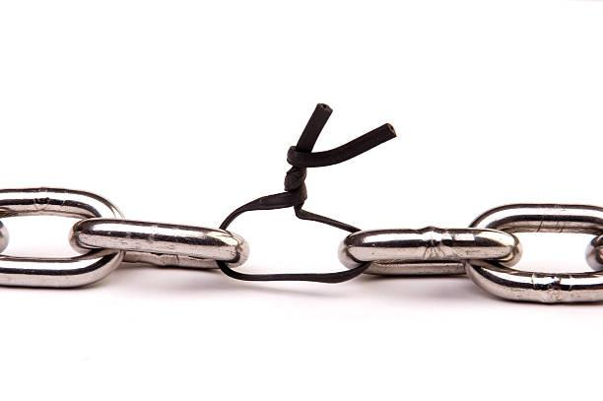
Plausible Reasoning
A chain is only as strong as its weakest link, so the plausibility of my inference cannot be greater than my weakest thesis or piece of data. If my conclusion depends upon p and p is somewhat plausible, I should not over-state the strength of my position.
p ⊃ q = (If John owns a 22 caliber pistol, then he committed the crime): (.2, or minimal plausibility; “for all we know, he killed his wife)
p = (John owns a 22 caliber that was recently discharged): (1.0, unqualifiedly true, established fact)
The argument is: [p & (p ⊃ q)] ⊃ q = .2

Slide 13
Weakest Link (continued)
The above is deductively valid (Affirming the Antecedent), but the conclusion is only as strong as the weakest link. The weakest link is p ⊃ q, which has a plausibility index of .2 (It is plausible that “if he owns a 22 caliber pistol, then he killed his wife” who was shot with a 22 caliber. It is not certain, nor is it implausible. The conclusion (or the argument in total) enjoys a plausibility index of .2, for it is only as strong as the weakest link.

Slide 14
A Simple Example of Plausible Reasoning
Problem: To determine the missing letter in the written sentence:
“He m_t the men coming in.”
What is the most plausible estimate?

Slide 15
Plausible Reasoning
Certain high-plausibility theses (data) are clearly present in the epistemic background (K) here:
The sentence at issue (“He m_t the men coming in”) is an English sentence that makes good sense. (.9)
The missing letter is a vowel. (.9)
The incomplete word at issue (“m_t”) is an ordinary English word. (.9)

Slide 16
Plausibility Index
0 = absolutely implausible
.1 = somewhat plausible
.5 = moderately plausible
.7 = very plausible
.9 = highly plausible
1 = established fact.
Thus, {a, b, c } are highly plausible = .9

Slide 17
Plausible Reasoning
“A wide range of specific alternatives can be projected here. Many of these can be ruled out immediately as conflicting with both of the high-plausibility theses (b) and (c), such as ‘the missing letter is z’.”
The only prospects that fail to pose a conflict with (b) are the vowels, which we will designate as (d₁, d₂, d₃, d₄, and d₅). Therefore, the missing letter is either A, E, I, O, U (respectively).
We will assign to these five theses a plausibility-index substantially lower than that of (a) – (c) – all of them taking the form S_{i}= {(a), (b), (c), (d_{i})}

Slide 18
Plausibility Index
1 = certain; .9 = highly plausible; .5 = moderately plausible; .2 = some plausibility; 0= implausible
|a| = .9
|b| = .9
|c| = .9
|d₁| = .2
|d₂| = .2
|d₃| = .2
|d₄| = .2
|d₅| = .2

Slide 19
At this point, we want to take the entire set (S) of data and determine our possible sub sets (S₁, S₂, S₃, …S_{i}), in order to determine the maximally consistent subset. To accomplish this, what we will do is we will dismiss data that is inconsistent, thus creating a “negative sub set” (S – {p₁, p₂, p₃…p_{i}}, and this will be followed by a set containing the plausible index value of each dismissed thesis (or piece of data).

Slide 20
The goal here is not to dismiss highly plausible data. For example, if a sub set involves the dismissal of a piece of data having an index value of 1.0 (certain), then we know that this particular subset cannot be the true estimate.

Slide 21
Over-all datum-set:
S= { (a), (b), (c), (d₁) - (d₅) }
Maximally Consistent Subsets (m.c.s)
S₁= { (b), (c), (d₁) } = S – (a), (d₂), (d₃), (d₄), (d₅): |.9| |.2| |.2| |.2| |.2|
S₂= { (a), (b), (c), (d₂) } = S - (d₁), (d₃), (d₄), (d₅): |.2| |.2| |.2| |.2|
S₃= { (b), (d₃) } = S – (a), (c), (d₁), (d₂), (d₄), (d₅): |.9| |.9| |.2| |.2| |.2| |.2|
S₄= { (b), (d₄) } = S – (a), (c), (d₁), (d₂), (d₃), (d₅): |.9| |.9| |.2| |.2| |.2| |.2|
S₅= { (b), (d₅) } = S – (a), (c), (d₁), (d₂), (d₃), (d₄): |.9| |.9| |.2| |.2| |.2| |.2|
Only one m.c.s avoids dropping the high plausibility thesis (a), namely, S₂= { (a), (b), (c), (d₂) }

Slide 22
Conclusion
He mat the men coming in
He met the men coming in
He mit the men coming in
He mot the men coming in
He mut the men coming in

Slide 23
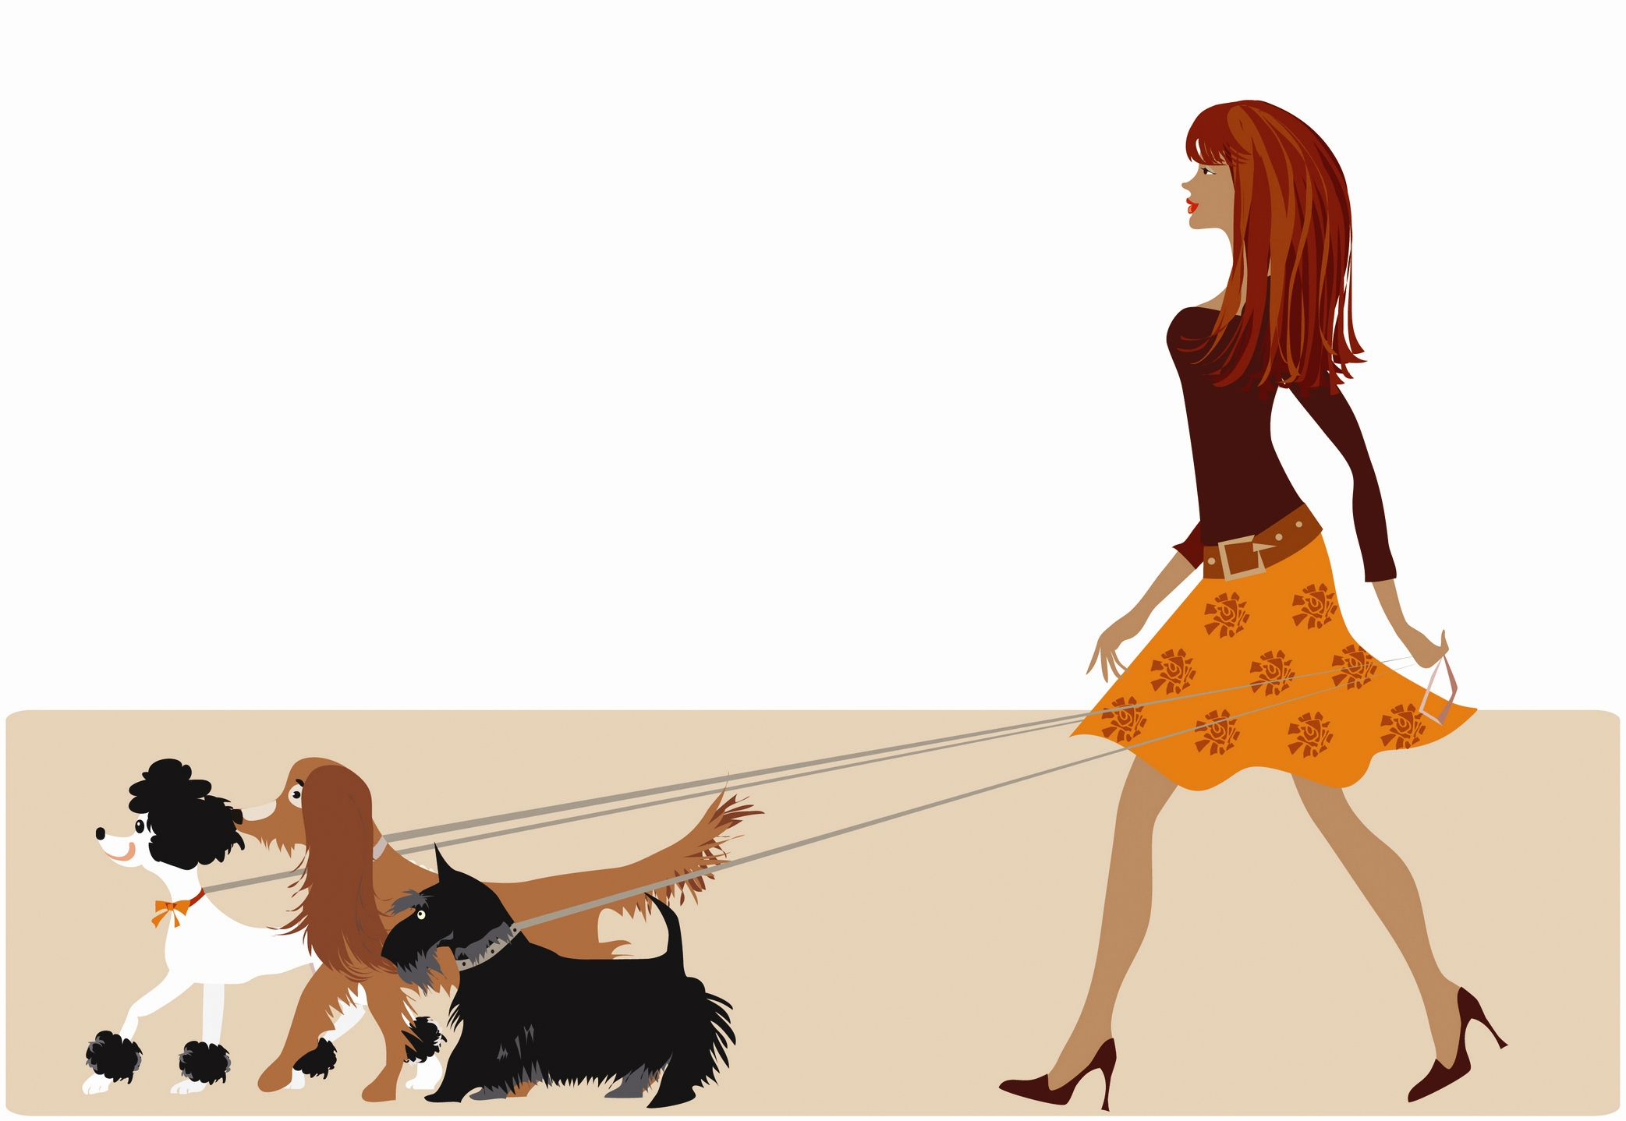
Plausible Inference on the basis of available information
Background information:
One of my neighbours is Emily. She is a big girl, in her early 20s. She has red hair, and she has two dogs: one a big dog, the other a little pup that is growing fast. Both are white dogs.

Slide 24
Inference on the basis of incomplete information
I am going for a walk and up ahead, I see a young girl walking two dogs. She appears to be a rather big girl, and she appears to have red hair. The dog to her right is a small dog, the dog on her left hand leash is behind a tree.
Inference: That’s Emily. Why?
If I see Emily out for a walk, then I will see someone with red hair, and two dogs next to her.
That’s just what I saw.

Slide 25
As I walk, I begin to question my inference. The greater the distance, the less is the precision (less information), but as distance decreases, the precision increases (more information). The dog on her right hand leash appears to be tiny, and Emily’s pup is growing—the last time I saw it, it was small, but not tiny. That girl does not seem as tall, at least not in relation to her dog—Emily is quite tall in relation to her dog.
I only know one girl with red hair and two dogs in this neighborhood. What is the probability that there are two girls, of the same build, having the same color hair, owning two dogs (one large, the other small), and who walk the same route every day, and yet I have only seen one of them?
Ultimately, I don’t know, because I’ve never tested for it. But I would guess: low probability. On what basis? On the basis of information that is available, which is incomplete.

Slide 26
Inference on the basis of incomplete information
As I move closer to this girl, I notice that she is not as tall as Emily, and finally the dog on her left hand leash comes out into full view, and the dog is black. Moreover, the dog on her right is clearly smaller than Emily’s smaller dog. Her hair is red, but not as bright a red as Emily’s.
Greater precision permits more detailed information

Slide 27
Set of Information
Initially, the inference seems to be almost certainly correct. As information is gathered, the plausibility that my perception was accurate changes. Soon it becomes highly implausible that this is Emily, and in time, it is falsified on the basis of new data that is inconsistent with my original set (S) of consistent data about Emily:
S = (big girl, bright red hair, big white dog, If I see Emily, she will have a big white dog and small dog, If that is Emily, she will have bright red hair, little white pup, big/medium height girl, brown/red hair, big black dog, tiny white pup with curly hair).
The problem with this set is that it is overdetermined. There is an embarrassment of riches. The data is inconsistent. Plausible reasoning is a matter of bringing maximal consistency to our data.

Slide 28
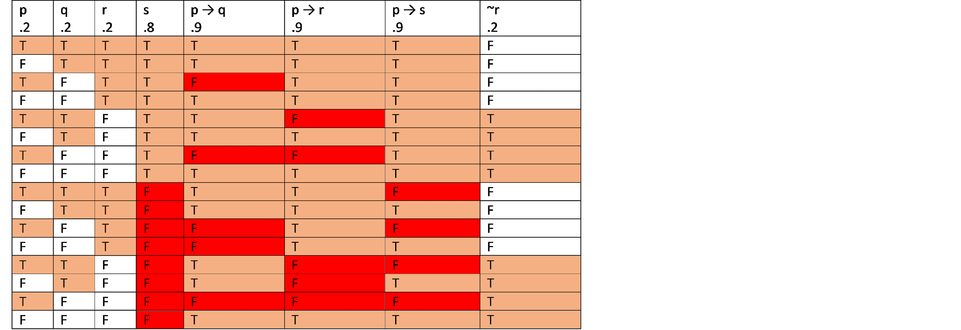
Truth Table
p = that is Emily (I’m at a distance, my eyes are not great, so it is plausible but defeasible (.2))
q = bright red hair (Again, I’m at a distance, so it is plausible but defeasible (.2))
r = walks a big white dog (I can’t see the dog, it is behind a tree, but I am guessing it is “Sofie”: plausible, (.2))
s = walks a small white pup (The dog I see is small and white, so I estimate it is a pup, but it may not be: highly plausible (.8))
p → q = If that is Emily, then that girl has bright red hair (very high plausibility (.9)).
p → r = If that is Emily, then the dog on her leash is a big white dog. (very high plausibility (.9)).
p → s = If that is Emily, then the other dog is a small white pub. (very high plausibility (.9)).

Slide 29
The dog on her left is out of sight (behind a tree), the dog to her right is a small white dog (it may or may not be a pup). I am not certain it is Emily, I am not certain that the girl’s hair is bright red.
Notice that Sets 3, 5, 7, 9, 10, 11, 12, 13, 14, 15, and 16 have to discard highly plausible data, which renders them implausible. Set 1 at this point is the most plausible.
After a few minutes, the dog on the left comes into full view. It is a large black dog (~R), whose plausibility index value is now at 1.0 (certain).
p = that is Emily
q = bright red hair
r = walks a big white dog
s = walks a small white pup
p → q = If that is Emily, then that girl has bright red hair
p → r = If that is Emily, then the dog on her leash is a big white dog.
p → s = If that is Emily, then the other dog is a small white pub.

Slide 30

Now we see that the big dog on her left is black, not white, and so ~r becomes certain. Thus, “r” becomes false.
S₆, S₈
Now sets 1, 2, 3, and 4 have to discard a virtually certain piece of data, and so 1 – 4 become implausible. Set 6 and 8 are the only two remaining maximal consistent subsets that do not discard highly plausible data. Both indicate it is not Emily, but 6 indicates this girl (who is not Emily) has bright red hair, while 8 indicates that she does not. If upon further investigation it is discovered that this girl does not have bright red hair, but brown/red hair, then ~q will render p false. In due time, it is clear that she does not have bright red hair. Set 8 becomes the most plausible set

Slide 31
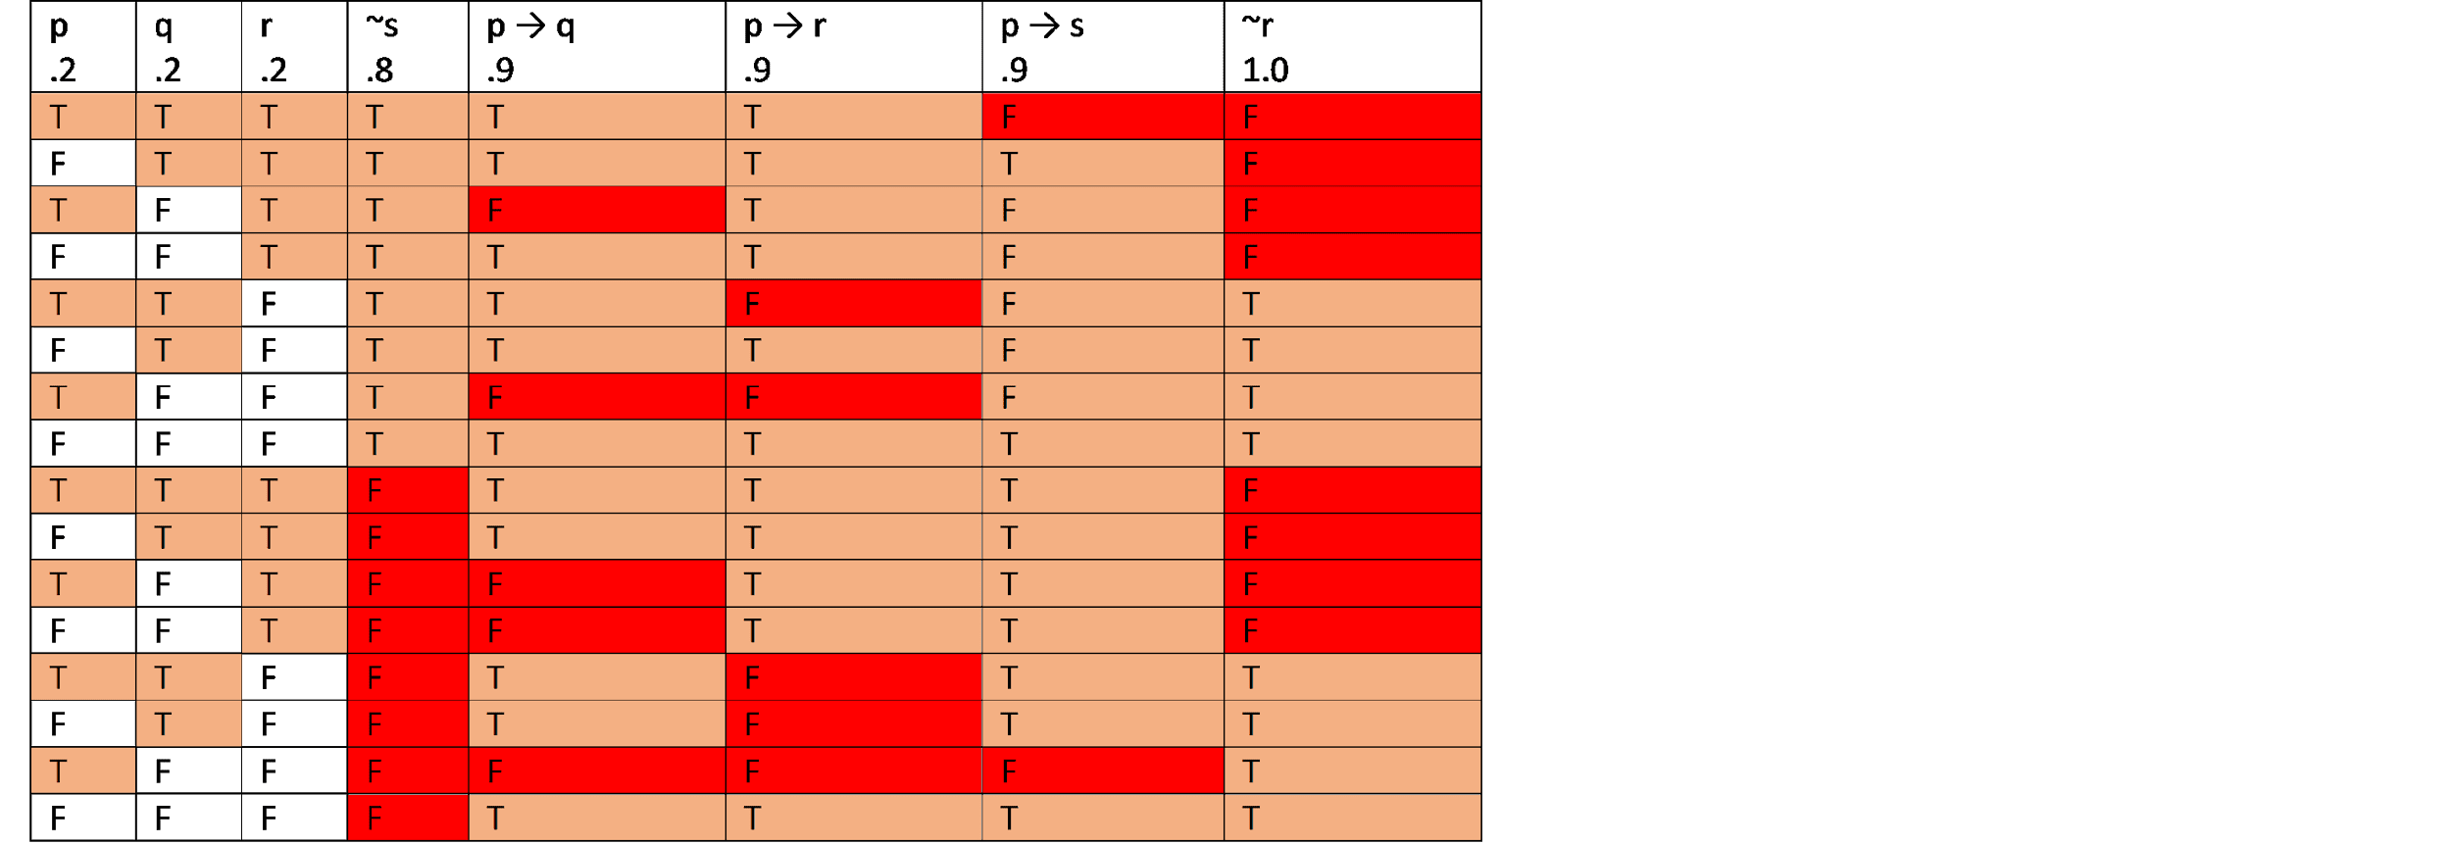
s becomes ~s, which enjoys high plausibility
S₈
If it turns out that the small dog on the right is probably not a pup, then ~s becomes .8 and s becomes .1 (low plausibility).
Notice that what this does is it corroborates Set 8 as the most optimal estimate. This is not Emily.
It is possible that it is Emily, she dyed her hair, and she’s walking a neighbor’s black dog and a small white dog that is not a pup. But this is very unlikely.

Slide 32
Truth as System
Truth is indeed the conformity between what is in the mind and what is (definition), but knowing “what is” is not always easy. Most of the time we only have a “best estimate”, a maximally plausible estimate. The criteria for truth is not the definition, but the following parameters:
The standards of inductive plausibility inhere in the parameters of cognitive systematization:
Completeness: comprehensiveness, avoidance of gaps or missing components, inclusiveness, unity and integrity as a genuine whole that embraces and integrates all its needed parts.
Cohesiveness: connectedness, interrelationship, interlinkage, coherence, a conjoining of the component parts, rules, laws, linking principles; if some components are changed or modified, then others will react to this alteration.
Functional simplicity and economy: elegance, structural economy, tidiness in the collaboration or coordination of components, harmony and balance, symmetry.
Functional efficacy: efficiency, effectiveness, adequacy to the common task, versatility and range and power of operating principles.
Consonance: consistency and compatibility, coherence, absence of internal discord or dissonance; harmonious mutual collaboration or coordination of components, “having all the pieces fall into proper place”.
Functional regularity: lawfulness, orderliness of operation, uniformity, pattern conformity, normality (conformity to the “usual course of things”)
The best estimate is the most complete, coherent, economical, simple and elegant, harmonious, consistent, has great range, lacking internal discord, coordinated, orderly, lawful, uniform, etc.

Slide 33
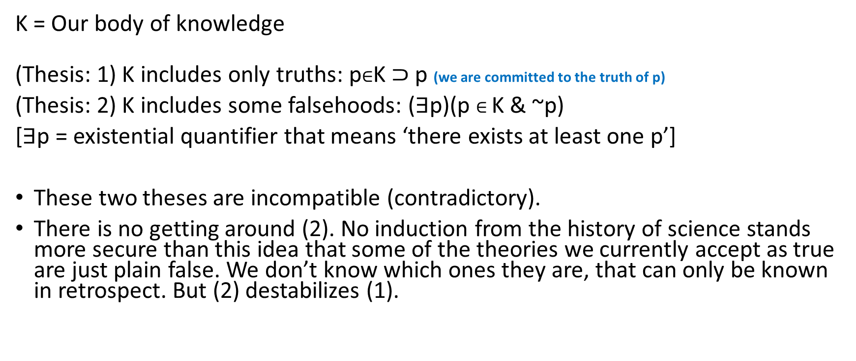
An Apory (aporia)

Slide 34
An Apory (continued)
So, we have no real choice but to a) abandon (1) or b) weaken (1).
Fundamental axiom of philosophical method: “Never simply abandon. In the face of insuperable difficulties, introduce distinctions and qualifications that enable you to save what you can of your commitments.”
There are various ways of effecting the unavoidable weakening of thesis (1).

Slide 35
Philosophical/Epistemological Positions
Probabilism
Sophistry
Radical Skepticism
Approximationism
Presumptionism or Fallibilism
Statisticism or Regulism
Discriminationism
Instrumentalism
Inconsistency Tolerance

Slide 36
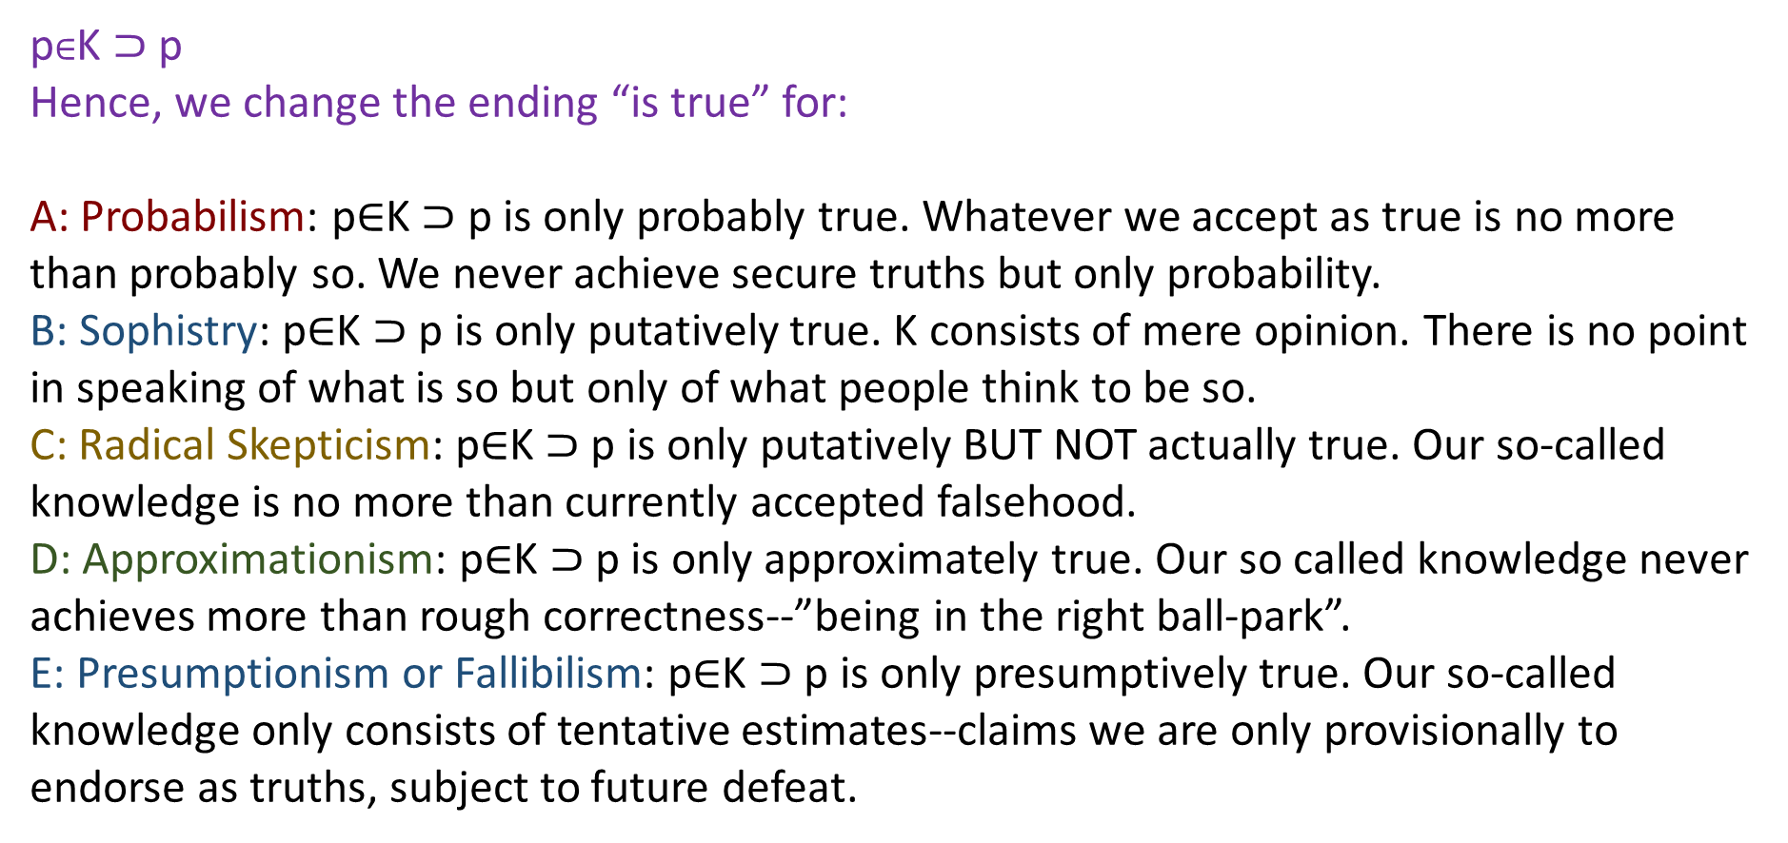

Slide 37
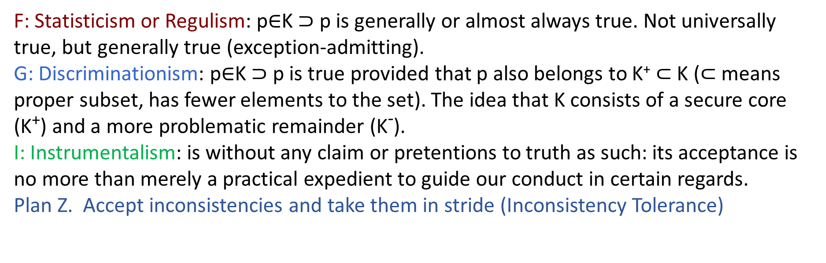
* Nicholas Rescher adopts E & G together (Presumptionaism/Fallibilism and Discriminationism), arguably the two most plausible positions.

Slide 38
Good thinking is about bringing maximally consistent plausibility to our own epistemic framework (the set of data through which we interpret the world around us). As new data (or theses) are added to our existing set of data, the plausibility index of much of that data changes and, if we are honest thinkers, we try to re-establish coherence and maximal consistency to that new set of data. That will involve discarding data that are inconsistent with data that has greater plausibility. What we want to do is avoid discarding highly plausible theses.
This epistemic process is an ongoing one, which is why some of us—those who make the effort to think—change our minds throughout our lives. Science is a matter of plausible reasoning, which is why the history of science is evolutionary and revolutionary (there has been a great deal of “mind changing”, data discarded, new data brought in that raises the plausibility index of old data that was considered implausible, etc.). So too is the history of philosophy evolutionary and revolutionary—although it has a very different kind of trajectory. History too is subject to the same developmental law.
One important lesson to take away from this is the importance of avoiding the habit of “over-stating your case”. We do not always know for certain whether our data is correct (most often, the plausibility index is less than 1.0), nor do we ever know whether we have enough data, and whether the plausibility indexes of our existing data will change as a result of additional data in the future, etc.
Hence, the importance of cultivating a certain degree of epistemic humility—not to mention rejecting a spirit of “dogmatism” (a stubborn unwillingness to examine new data for fear of upsetting the applecart of one’s own conceptual framework). Other adjectives that describe the same attitude: self-righteous, closed-minded, absolutistic, opinionated, one-sided, over-confidence, cocksure, epistemic hubris, etc.)

Slide 39
Why do these points argue for the need for collaboration? In other words, is the production of knowledge a communitive process?

