Slide 1
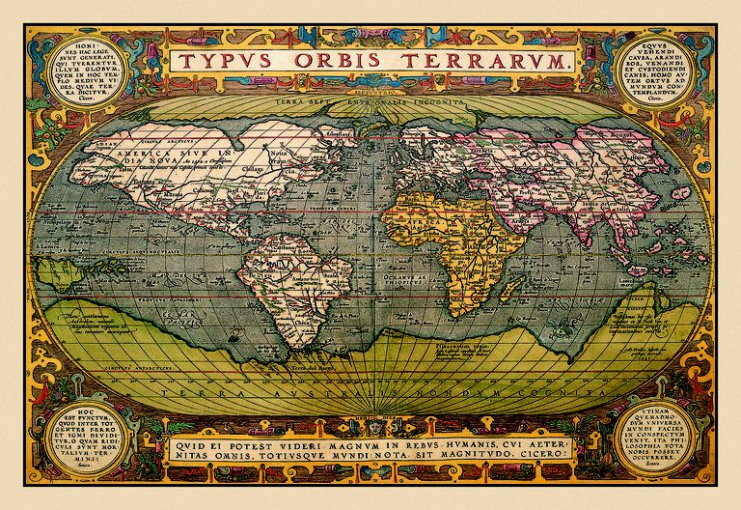
Maps
A Metaphor
(based on Types of Maps: https://www.thoughtco.com/types-of-maps-1435689)

Slide 3
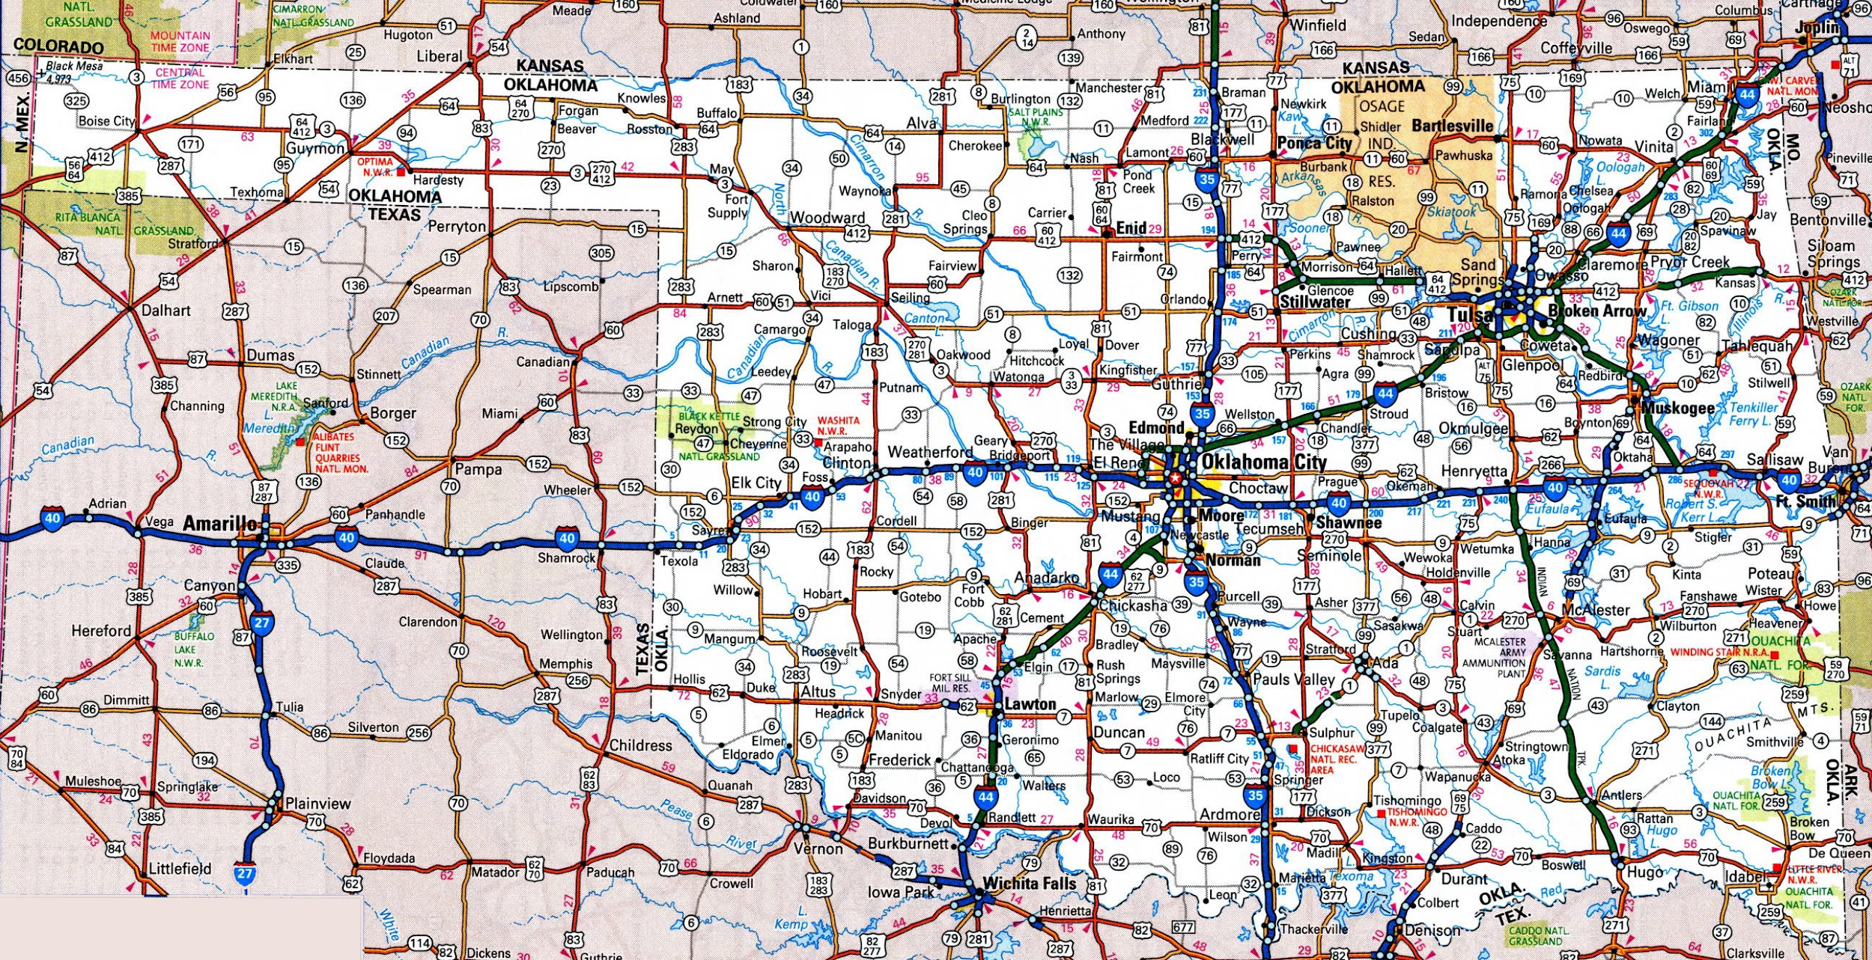
ROAD MAPS
A road map is one of the most widely used map types. These maps show major and minor highways and roads (depending on detail), as well as things like airports, city locations and points of interest such as parks, campgrounds, and monuments. Major highways on a road map are generally shown in red and larger than other roads, while minor roads are a lighter color and a narrower line.
A road map of California, for example, would depict Interstate highways with a wide red or yellow line, while state highways would be shown in a narrower line in the same color.
Depending on the level of detail, the map may also show county roads, major city arteries, and rural routes. These are usually depicted in shades of gray or white.

Slide 4
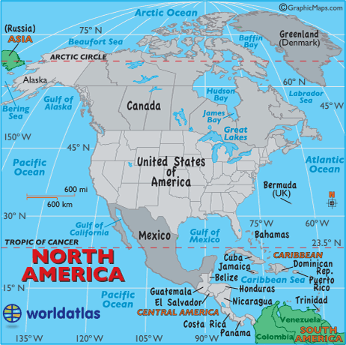
POLITICAL MAPS
A political map does not show topographic features like mountains. It focuses solely on the state and national boundaries of a place. They also include the locations of cities large and small, depending on the detail of the map.
A common type of political map would be one showing the 50 U.S. states and their borders along with the United States' international borders.

Slide 5
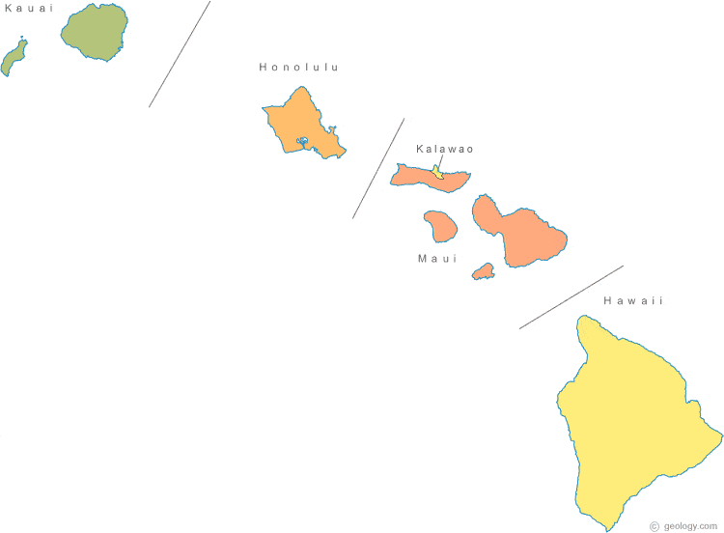
PHYSICAL MAPS
A physical map is one that documents landscape features of a place. They generally show things like mountains, rivers, and lakes. Bodies of water are always shown with blue. Mountains and elevation changes are usually shown with different colors and shades to show relief. Normally on physical maps, green shows lower elevations while browns show high elevations.
This map of Hawaii is a physical map. Low elevation coastal regions are shown in dark green, while the higher elevations transition from orange to dark brown. Rivers are shown in blue.

Slide 6
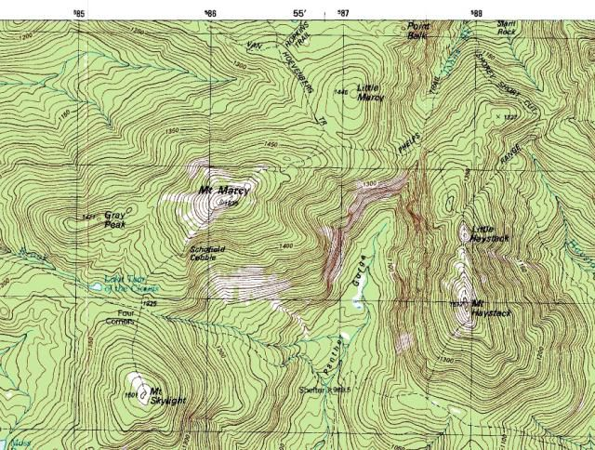
TOPOGRAPHIC MAPS
A topographic map is similar to a physical map in that it shows different physical landscape features. Unlike physical maps, this type of may uses contour lines instead of colors to show changes in the landscape. Contour lines on topographic maps are normally spaced at regular intervals to show elevation changes (e.g. each line represents a 100-foot (30m) elevation change) and when lines are close together the terrain is steep.
This topographic map of the Big Island of Hawaii has contour lines that are close together near the steep, high elevation mountains of Mauna Loa and Kilauea. By contrast, the low elevation, flat coastal areas show contour lines that are spread apart.

Slide 7
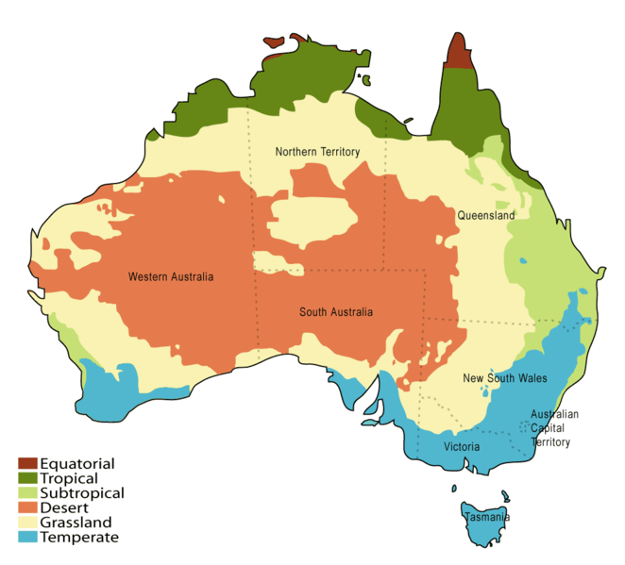
CLIMATE MAPS
A climate map shows information about the climate of an area. They can show things like the specific climatic zones of an area based on the temperature, the amount of snow an area receives or the average number of cloudy days. These maps normally use colors to show different climatic areas.
This climate map for Australia uses colors to show differences between the temperate area of Victoria and desert region in the center of the continent.

Slide 8
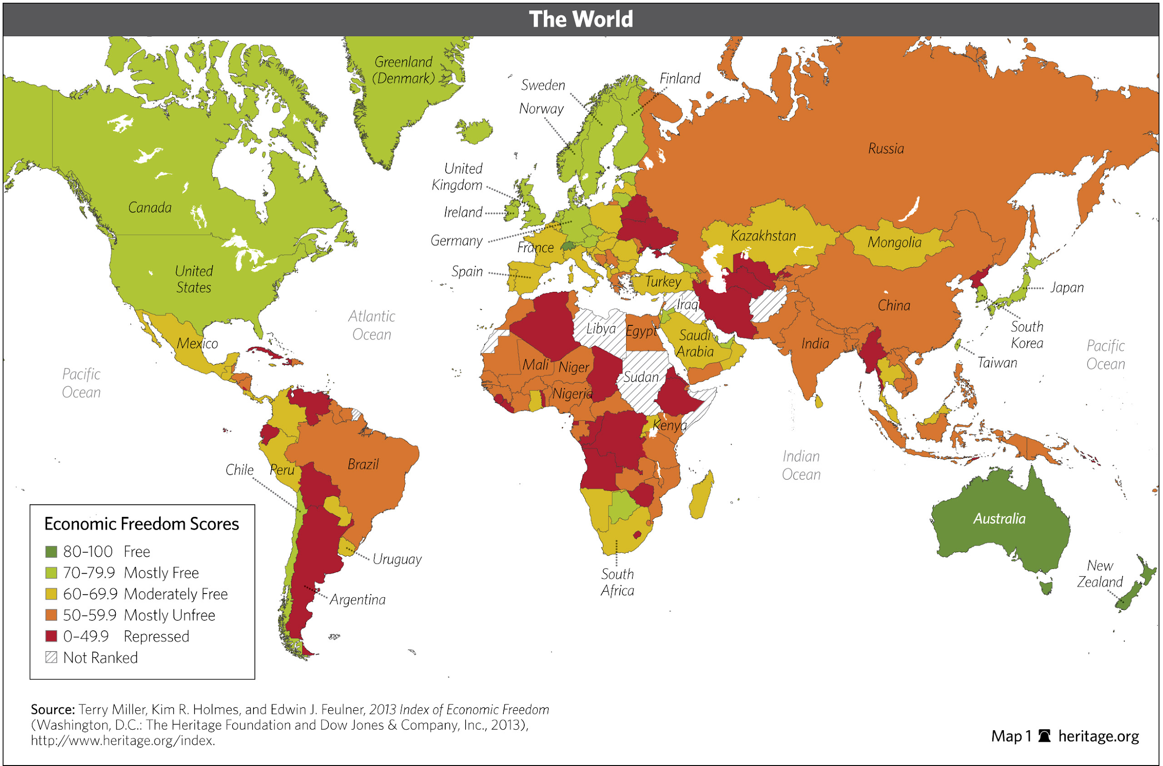
ECONOMIC OR RESOURCE MAPS
An economic or resource map shows the specific types of economic activity or natural resources present in an area through the use of different symbols or colors depending on what is being shown on the map.

Slide 9
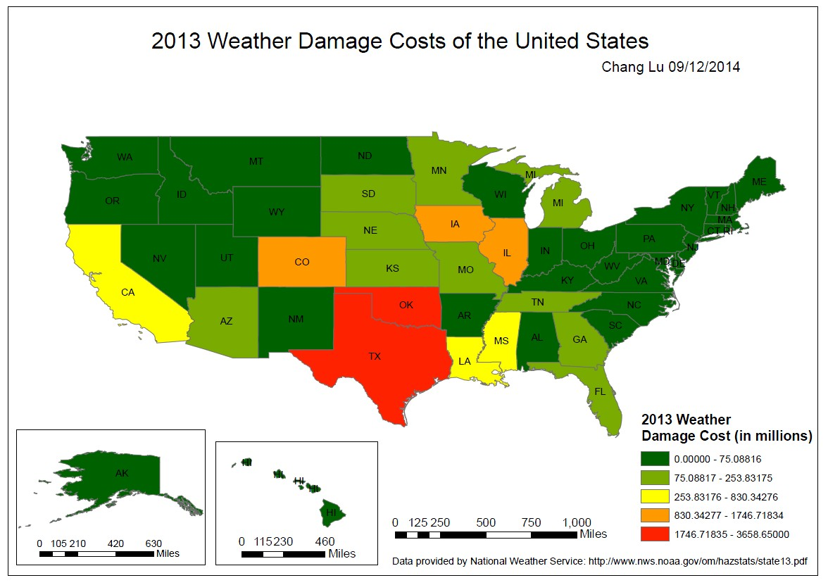
THEMATIC MAPS
A thematic map is a map that focuses on a particular theme or special topic. They are different from the six aforementioned general reference maps because they do not just show natural features like rivers, cities, political subdivisions, elevation, and highways. If these items are on a thematic map, they are background information and are used as reference points to enhance the map's theme.
This Canadian map, which shows changes in population between 2011 and 2016, is a good example of a thematic map. The city of Vancouver is broken down into regions based on the Canadian Census. Changes in population are represented by a range of colors ranging from green (growth) to red (loss) and based on percentage.

Slide 10
Knowledge can be compared to a map
Our knowledge, currently, is like a map of the world. There is a real distinction between a map and the reality that is mapped. Our knowledge can take place on different levels of abstraction (1st, 2nd, 3rd), our knowledge is incomplete, reality is much larger and more complex than our current knowledge of it (as is a map). A map serves a useful purpose, a map is a response to certain needs we have (to solve certain problems that interest us--how to get to point A, or where is infant mortality highest and is that correlated with any other data we might have? etc.)

Slide 11
Comparing (continued)
We think within an epistemic framework (conceptual framework, epistemic model of the real, total set of data). That framework is made up of inductive inferences that have only a degree of plausibility, deductions that are certain (i.e., ½ x ½ = ¼, all triangles are polygons), concepts locked in a language that is rooted in history (i.e., connaitre, savoir, kalon, right), first principles that are certain (non-contradiction), biases that incline us to inductive error (WYSIATI, confidence thresholds rooted in emotion), personal knowledge rooted in our own unique experiences (I know Islam from within), shared cultural “knowledge” (i.e., current scientific estimates learned in school, beliefs, i.e., putative knowledge), etc. That conceptual framework (total set of data) is a map, as it were--an imperfect representation of the real.

Slide 12
Comparing (continued): Reality is the measure of the mind (not vice versa)
It is reality (i.e., the city) that measures the quality of a map. So too, our current epistemic framework is measured by the real. Reality changes (i.e., cultures, cultural trends, etc.), and with these changes come new data (mining new data, as it were). New data changes the plausibility indexes of our current set of data, thus leading to new and better estimates (supposedly better).
Reality, on many other levels, remains relatively constant (uniform). If there were no uniformity to the city or country we are mapping, the map would be useless--knowledge would be impossible. I.e., human nature does not change (highly plausible thesis).

Slide 13
Distinct Ways of Knowing and Areas of Knowledge
Just as it is not possible to determine how to get from New York to Toronto via a thematic or political map, so too it is not possible to determine (know) what is the morally right choice to make via the scientific method, or to determine the cause of cancer through emotion (i.e., I feel deep down that aspartame causes cancer). Physics cannot solve an economic problem, nor can economics solve a psychological problem.

Slide 14
Comparing (continued)
Similarly, one cannot determine the answer to the question: “What does it mean to be a human being?” via atomic physics, because physics “abstracts” from a consideration of all those things it cannot “investigate” empirically, and “intellect and will” for example, cannot be empirically investigated, but only rationally investigated (we reason to our conclusions). One cannot, for example, see a universal idea.

Slide 15
Implications
We need to keep in mind that although reality might appear to us as very clear, it is always larger and more complex than our epistemic “map” permits us to see. If the map continues to become more sophisticated and increasingly complex, then we should always be aware of the limitations of our current map and be open to continual improvement, sophistication, complexity, etc. In other words, closed mindedness is a completely unwarranted posture to take. Epistemic smugness (overconfidence) is rarely justified. Life is an ongoing learning process.
There is much about the old maps that are correct and have remained unchanged. See next slide

Slide 16
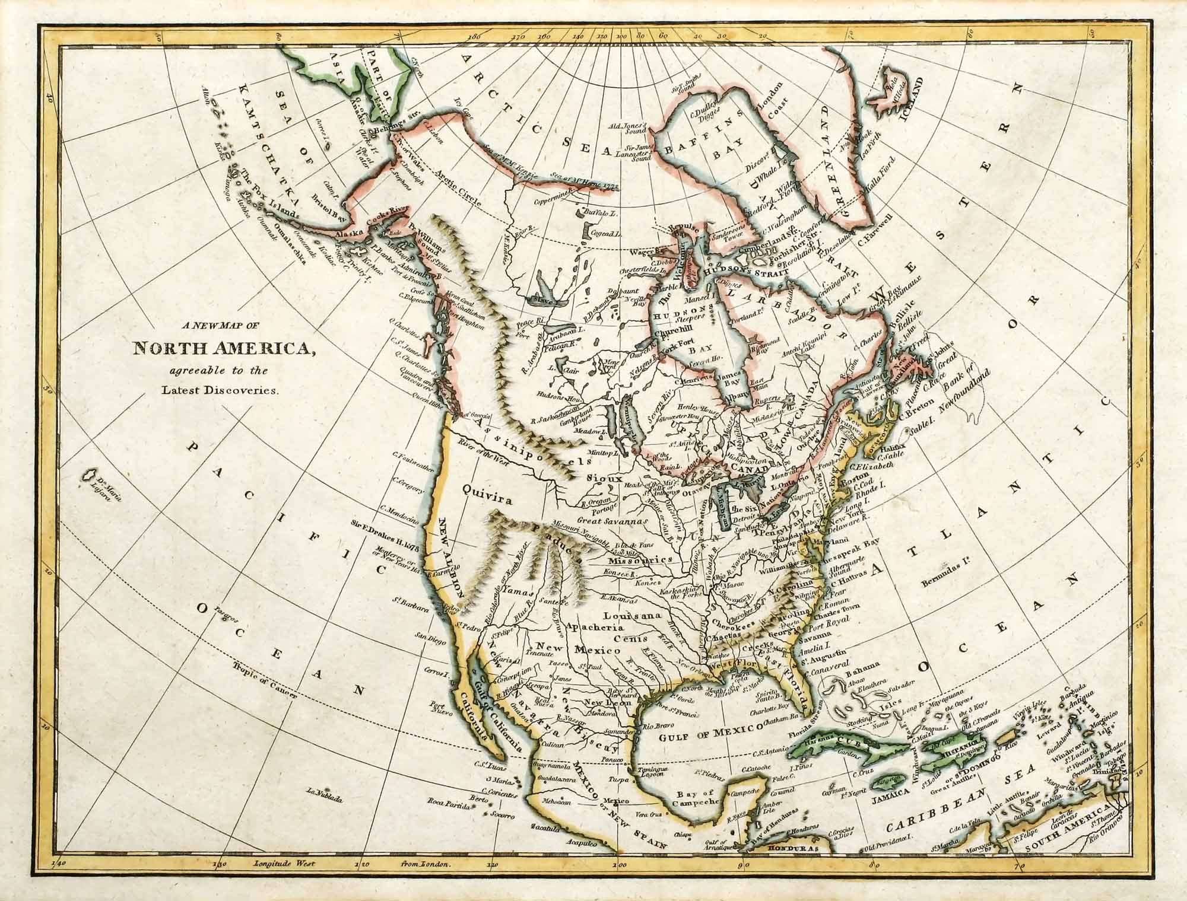

Slide 17
Implications continued
This analogy is very limited, however. The old map is less useful than today’s maps, but the old philosophical systems (i.e., Aristotle’s Nicomachean Ethics) are extremely useful today (perennial truths). The Metaphysical ideas of thinkers like Aquinas or the philosophical ideas of Augustine or Plato are often very relevant and useful for dealing with specific questions that only require rational investigation.
There is no automatic “successionism”, as there is when it comes to technology and empirical science.
Also, we have been around the world. We’ve mapped the geological area that is the earth. All we need now is greater detail. But we have not mapped all of reality, not even in a general way.

